Slide 1
OGG REPLICATION TO SNOWFLAKE
Data Ingestion - Snowflake

Slide 2





E2E PROPOSED SOLUTION ARCHITECTURE
LOAD TO STAGE
MERGE
FDW
AWS Cloud
SnowPipe
RAW/
LANDING
STAGE
(TRANSIENT)
TARGET/
CONFORMED
Landing
S3 Properties
AVRO/PARQUET/CSV ?
??
Capture
Archive
Micro Batches driven via COPY INTO
Trail Files
PROCESS
LOG
METADATA

Slide 3
PROCESS_TYPE
PROCESS_TYPE_ID_PK
PROCESS_DESC
LOGGING PROCESS FRAMEWORK
PROCESS_JOB_CONFIG
JOB_ID_PK
PROCESS_TYPE_ID_FK
ENTITY_NAME
ENTITY_SCHEMA
IS_ACTIVE
LANDING DB
JOB_EVENT_LOG
EVENT_ID_PK
JOB_ID_FK
FILE_ID_FK
PROCESS_TYPE_ID_FK
EVENT_START_TS
EVENT_END_TS
ROWS_INS
ROWS_DEL
ROWS_UPD
EVENT_STATUS
ERROR_TEXT
PROCESS DB
BATCH_LOAD
BATCH_ID_PK
BATCH_START_TS
BATCH_END_TS
BATCH_STATUS
BATCH_COMMENTS
OGG_LANDING
FILE_ID_PK
ENTITY_NAME
ENTITY_SCHEMA
FILE_NAME
ROW_DATA (VARIANT)
PROCESSED_FLAG
BATCH_ID_FK

Slide 4
MICRO BATCH PROCESSING
START
Create BATCH_ID and update BATCH_LOAD as “STARTED’
Files available in S3
update BATCH_LOAD as “COMPLETED” with zero files processed
END
Trigger PROCESS ‘STAGE LOAD’ Generate EVENT_ID &
capture JOB_EVENT_LOG
Stage Load completed
update BATCH_LOAD as “COMPLETED”
No
Update JOB_EVENT_LOG as ‘FAILED’ for ‘STAGE LOAD’
Yes
Yes
All EVENTS ‘PASSED’
Update JOB_EVENT_LOG as ‘PASSED’ for ‘STAGE LOAD’
No
update BATCH_LOAD as “COMPLETED with Failures”
Trigger PROCESS ‘TARGET LOAD (MERGE)’ based on DML Operation
Generate EVENT_ID &
capture JOB_EVENT_LOG
Trigger Batch Monitoring on JOB_EVENT_LOG
Target Load completed
No
Update JOB_EVENT_LOG as ‘FAILED’ for ‘TARGET LOAD’
Yes
Update JOB_EVENT_LOG as ‘PASSED’ for ‘TARGET LOAD’

Slide 5
RECONCILIATION FRAMEWORK
Python - Snowflake

Slide 6





Reconciliation Framework
Generic Merge transformation via Snowflake SPs UPSERT/DELETE
Oracle FDW
Oracle
GG
Stage
Snowflake FDW
Oracle Gateway to connect to the system
Connect through Snowflake Python Connector
Profiles
Generate Hashkey (SHA256)
Hashkey Comparison
Excel Output and Email Automation
Full Actual Comparison
Full Comparison
Delta Comparison
Full Comparison (Columns Specified
Delta Comparison (Columns Specified)
Aggregate Comparison

Slide 7
Comparison Profiles
Full Actual Comparison
Full Comparison
Delta Comparison
Full Comparison (Columns Specified)
Delta Comparison (Columns Specified)
Aggregate Comparison (Columns Specified)
Extract Oracle Table
Generate hashkeys for oracle and snowflake tables
Filter based on load date, group by clause or sql queries
Generate hashkeys for oracle and snowflake columns specified
Filter based on load date, group by clause or sql queries
Summation of a column (datatype – int, float, number)
Extract Snowflake Table
Compare and post output in excel
Generate hashkeys for filtered data for oracle and snowflake tables
Compare and post output in excel
Generate hashkeys for filtered data for oracle and snowflake columns specified
Count number of records in a column
Compare and post output in excel
Compare and post output in excel
Compare and post output in excel
Compare and post output in excel

Slide 8
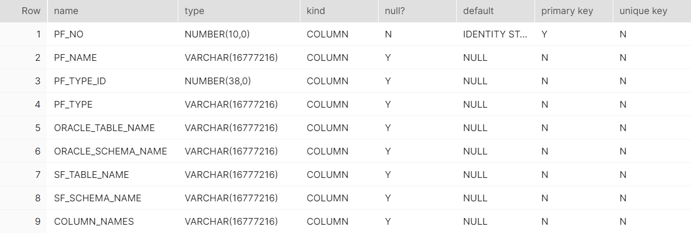
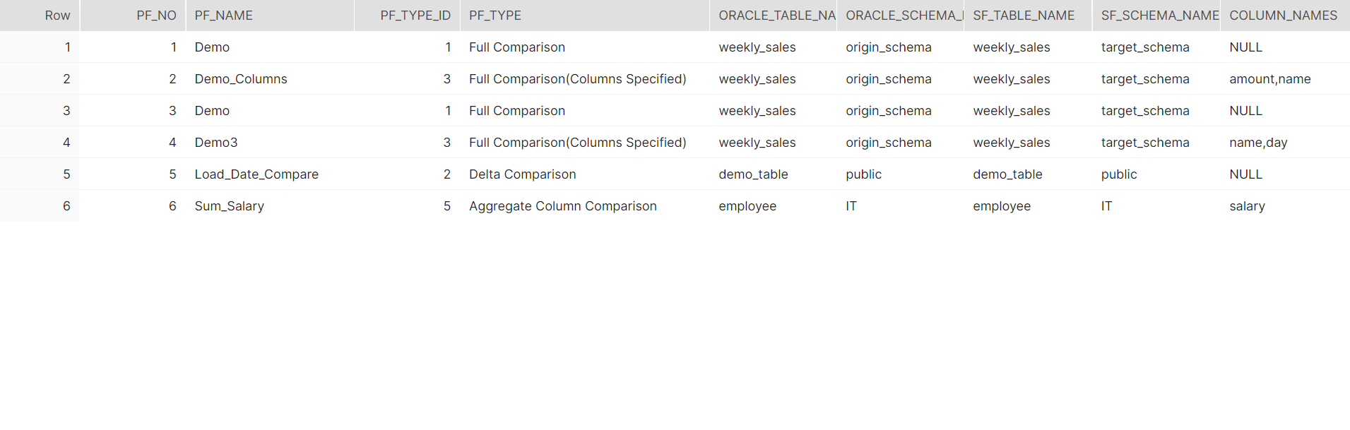
PROFILE DETAILS TABLE

Slide 9
PYTHON SCRIPTS FLOWCHART
START
Create PROFILE TYPE from given list of profiles
Profiles are stored in Snowflake
User selects a profile from the list of profiles
Table, Schema details fetched by Python
Invalid table name or schema name
No
Yes
Python calls a stored procedure which generates hashkey for each record
END
Pandas library extracts the records and compares them based on hashkey (MD5)
Email the excel to appropriate team for further inspection
Comparison Completed for matched records
Yes
Export the matched records to excel
No
Export the unmatched records to excel

Slide 10
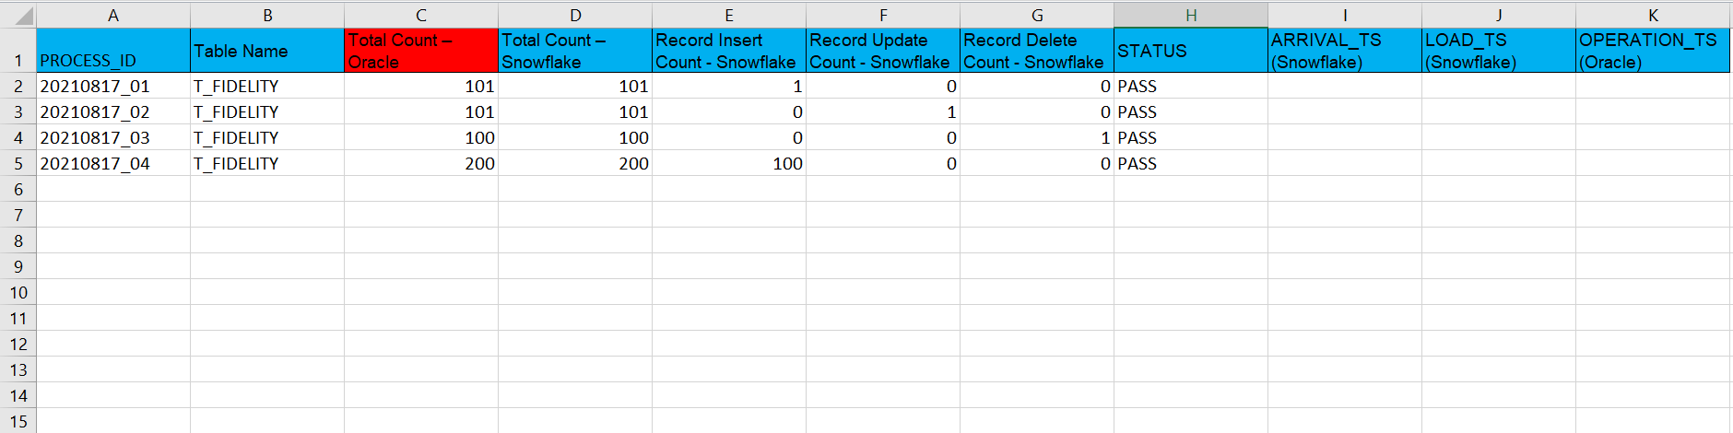
RECONCILIATION HISTORY TABLE

